Slide 1
Generative Adversarial Network (GAN) As A HPE GreenLake Service
Yogesh Choubey​, Sriram Ravishankar, Soumya RR,​ R Harish, Archana G S , ​ Anup Sahu Kumar,
Jinu Jolly Mariam, Shiju C & ​ S, Madhusoodhana Chari
April 21st, 2023

Slide 2
SECTION 1
THE CURRENT DATA MARKET

Slide 3
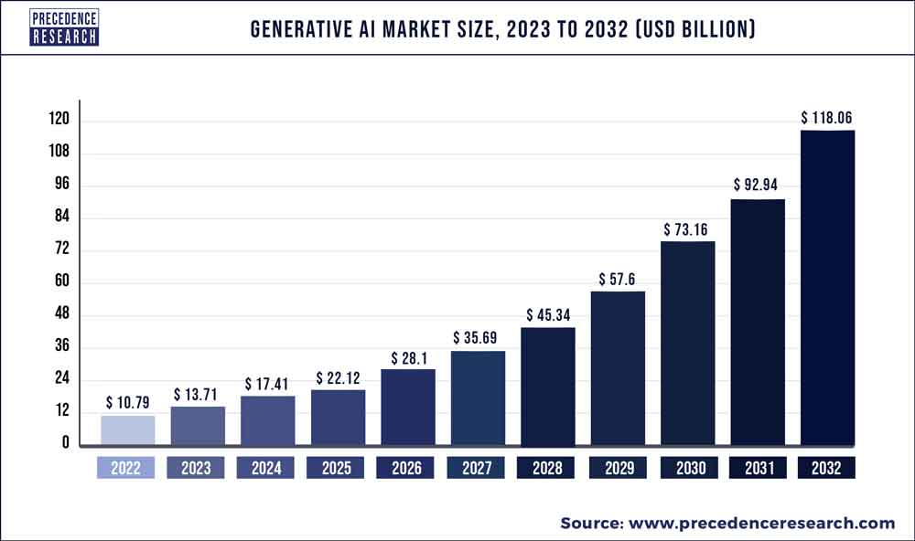
GENERATIVE AI
The Global generative AI market size -
10.79 billion in 2022
Projected to hit around USD 118.06 billion by 2032.
Growing at a CAGR of 27.02% b/w 2023 to 2032.

Slide 4

SYNTHETIC DATA
Derived from generative models preserves the statistical properties of the original dataset.
Synthetic data can be generated using different methods-
Statistically rigorous sampling from real data
Semantic approaches using Generative Adversarial Networks
By creating simulation scenarios where models and processes interact.
Helpful for companies to build models for scenarios where data is private, low-quality or simply does not exist at all.
Examples of Synthetic Data
Media data
Text data
Tabular Data
Unstructured Data
Financial services data
Manufacturing data
Notes:
the successful adoption of GANs requires,
Significant computational resources to enable faster model training, as well as sufficient storage capacity to accommodate the large amounts of generated data.
Lack of access to High-quality training data to develop models that inform business decisions is a significant challenge for organizations. Obtaining or creating such data can be challenging, especially in domains with limited data availability or data privacy concerns.
Developing and fine-tuning GANs consume time and require a Deep expertise of the underlying mathematical and statistical principles, as well as knowledge of the latest techniques and best practices.
The training process can be time-consuming and computationally expensive.

Slide 5

ISSUES WITH EXISTING DATA

Slide 6
SECTION 2
CAPABILITIES OF GAN

Slide 7
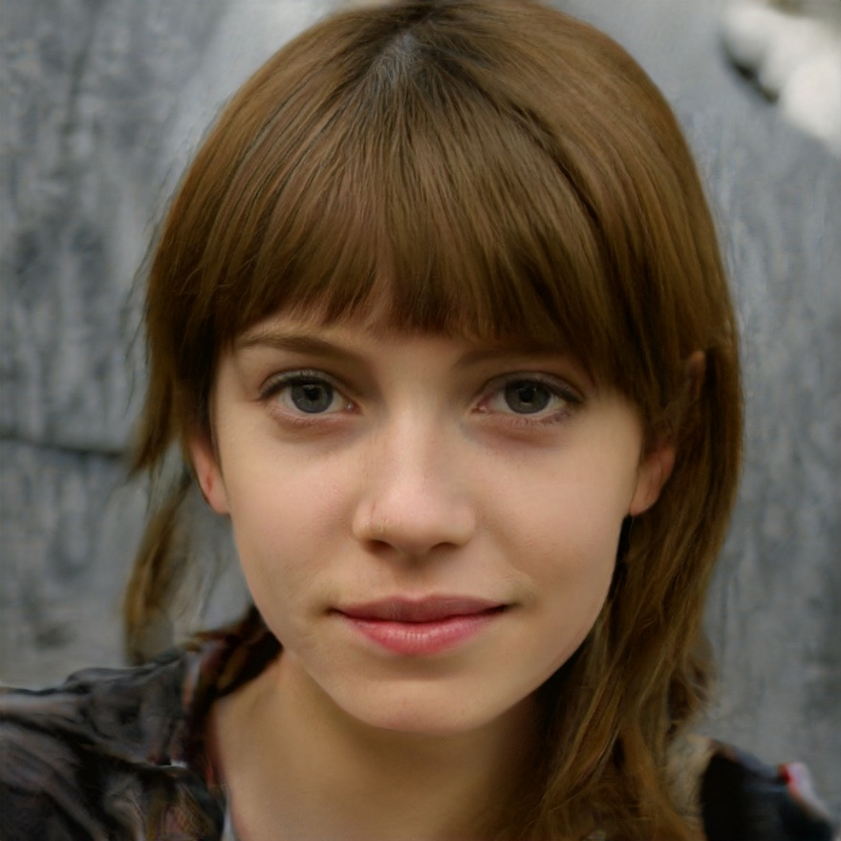
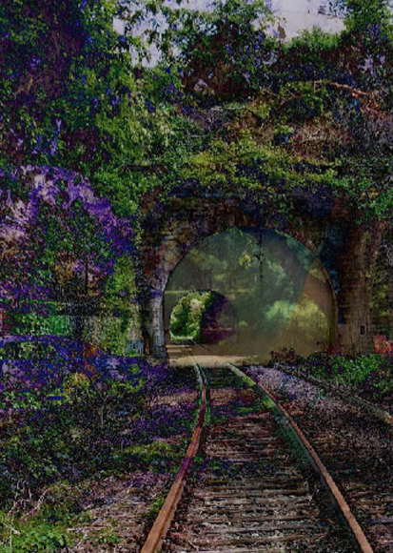
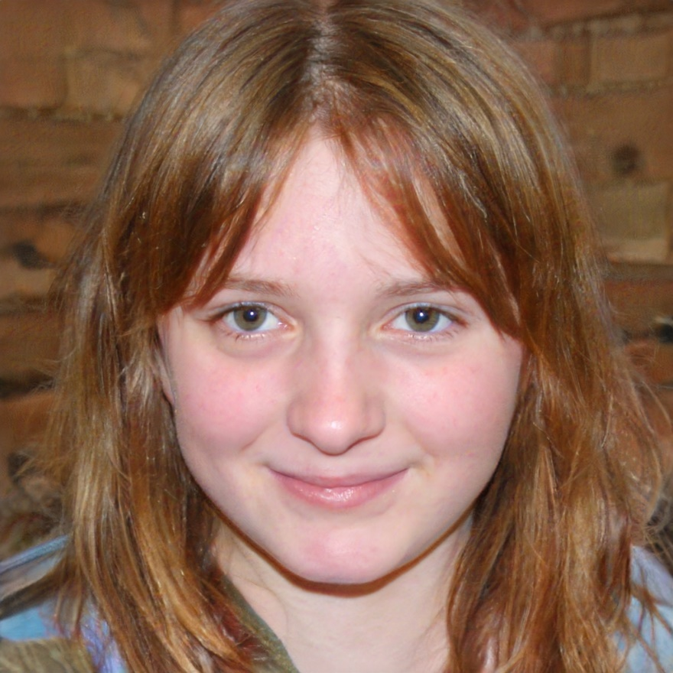
GAN GENERATED IMAGES
Image source - https://en.wikipedia.org/wiki/Generative_adversarial_network

Slide 8
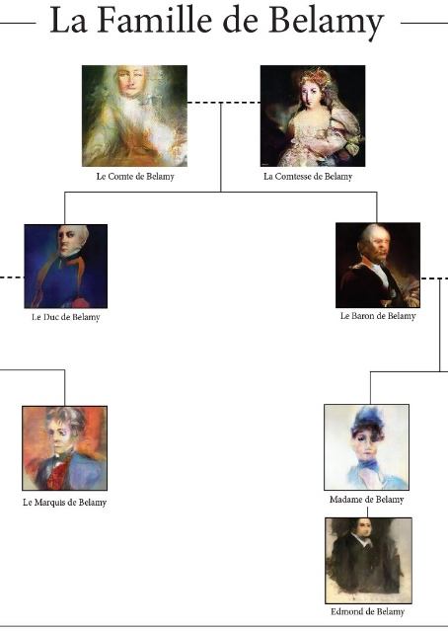
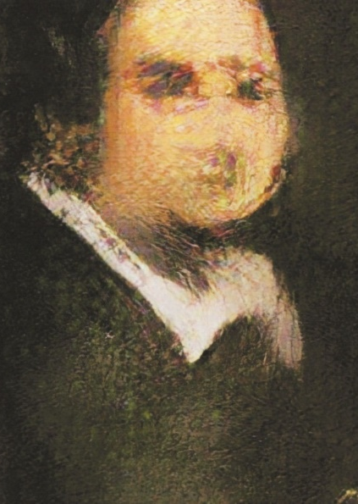
AI-GENERATED PORTRAIT FETCHES $432,500 AT AUCTION
“Edmond de Belamy,” is one of several members of a fictitious family created by by French AI engineers and artists Obvious using GAN.
About 15,000 portraits of the family from the last 600 years or so was used to train and generate this portrait.
Image source - https://en.wikipedia.org/wiki/Edmond_de_Belamy#/media/File:Edmond_de_Belamy.png

Slide 9
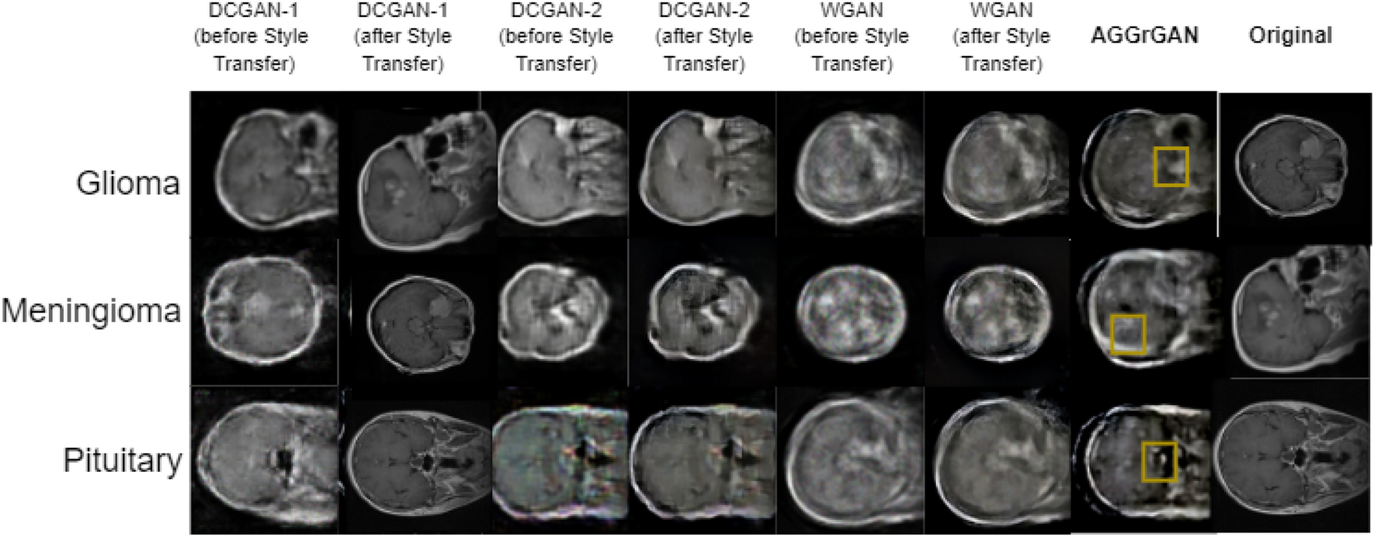
BRAIN TUMOR IMAGE GENERATION USING AN AGGREGATION OF GAN MODELS WITH STYLE TRANSFER
Image source - Scientific Reports:
Mukherkjee, D., Saha, P., Kaplun, D. et al. Brain tumor image generation using an aggregation of GAN models with style transfer. Sci Rep 12, 9141 (2022). https://doi.org/10.1038/s41598-022-12646-y

Slide 10
SECTION 3
BRIEF INSIGHT INTO GAN

Slide 11
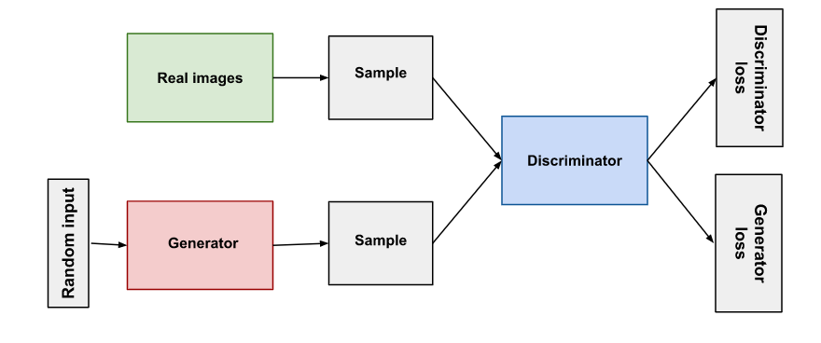
GAN ARCHITECTURE
A generative adversarial network (GAN) has two parts:
The Generator learns to generate plausible data. These instances become negative training examples for the discriminator.
The Discriminator learns to distinguish the generator's fake data from real data. The discriminator penalizes the generator for producing implausible results and gets penalized for also confusing generated and real data.
Both the generator and the discriminator are neural networks. They are trained simultaneously and through backpropagation, the discriminator's classification provides a signal that the generator uses to update its weights for improving accuracy.
Image source - https://developers.google.com/machine-learning/gan/gan_structure

Slide 12
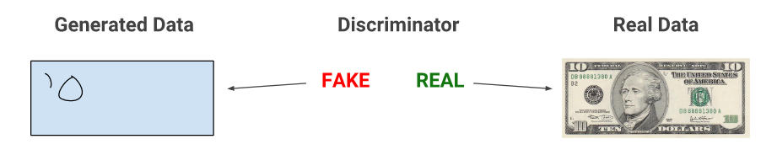
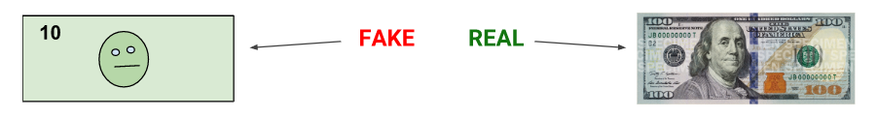

HOW DOES IT WORK?
When training begins, the generator produces obviously fake data, and the discriminator quickly learns to tell that it's fake:
As training progresses, the generator gets closer to producing output that can fool the discriminator.
Finally, if generator training goes well, the discriminator gets worse at telling the difference between real and fake. It starts to classify fake data as real, and its accuracy decreases.
Images source - https://developers.google.com/machine-learning/gan/gan_structure

Slide 13
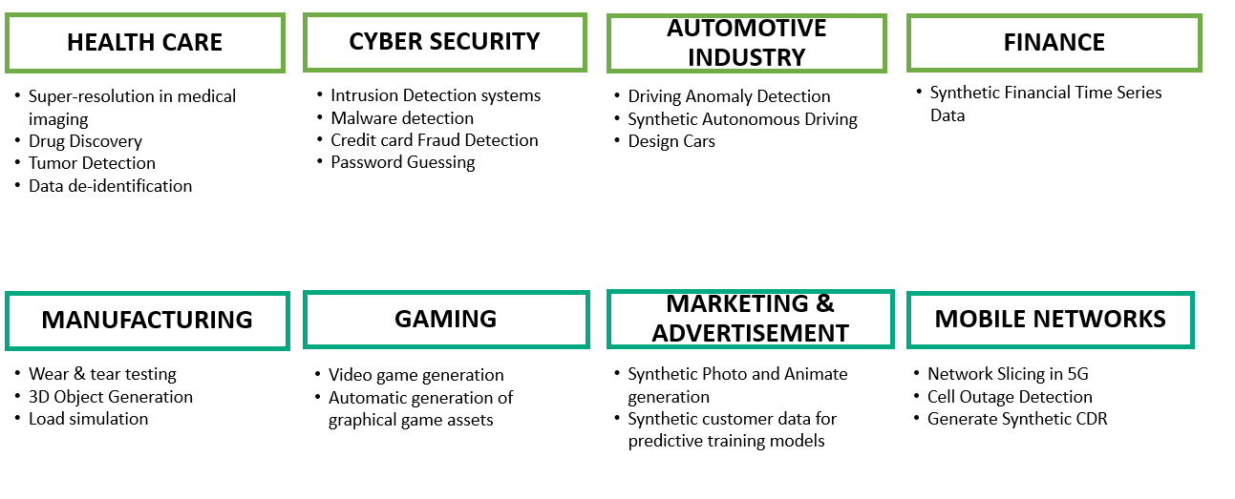
USE CASES

Slide 14
SECTION 3
GAN AS A HPE GREENLAKE SERVICE

Slide 15
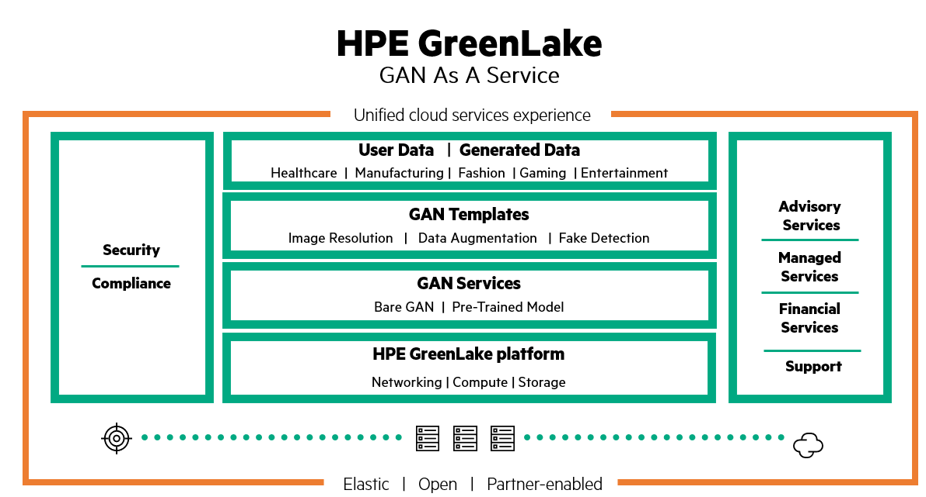
PROPOSED APPROACH

Slide 16
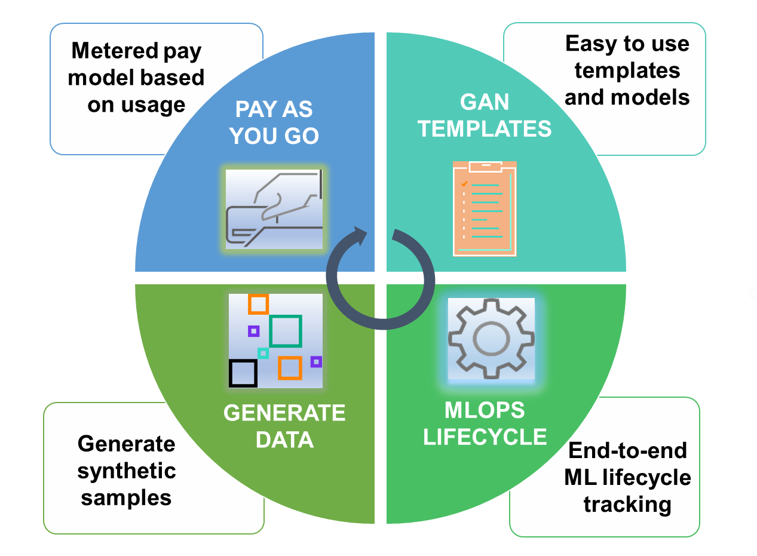
OUR SOLUTION

Slide 17
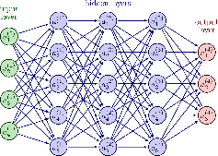



END USER ADVANTAGES with GAN As A Service
Generate High Quality Synthetic Data
No need of deep learning or GAN expertise to use the service
Option to choose from numerous pre-trained models or use bare GAN architecture
MLOps enabled platform
Leverage the service from HPE's GreenLake portal
Pay only for what you use
Green Lake Platform
Achieve Parallel computing with Determined AI
Access to wide range of comprehensive High-End Resources for faster training

Slide 18
COMPETITIVE OFFERINGS
AWS SAGEMAKER
NVIDIA DGX
HUGGING FACE

Slide 19
SECTION 4
NEXT STEPS

Slide 20
NEXT STEPS
Extend GAN As A Service to Generative AI As A Service
Onboard third-party state-of-the-art pre-trained models as a premium service
Build Carbon-aware models

Slide 21
ACKNOWLEDGEMENTS
Authors would like to acknowledge,
“Mopur, Satish Kumar” for mentorship on GANs.
“Sudhakaran, Sonu” for enumerating the technical details of GreenLake platform.
“Bhattacharya, Suparna” for guidance on content creation.

Slide 22
REFERENCES
[1] arXiv:2303.08774v3 [cs.CL] 27 Mar 2023.
[2] W. Li, "Image Synthesis and Editing with Generative Adversarial Networks (GANs): A Review," 2021 Fifth World Conference on Smart Trends in Systems Security and Sustainability (WorldS4), London, United Kingdom, 2021, pp. 65-70, doi: 10.1109/WorldS451998.2021.9514052.
[3] Kiru, Muhammad & Belaton, Bahari & Chew, Xinying & Almotairi, Khaled & Hussein, Ahmad & Aminu, Maryam. (2022). Comparative analysis of some selected generative adversarial network models for image augmentation: a case study of COVID-19 x-ray and CT images. Journal of Intelligent & Fuzzy Systems. 43. 1-20. 10.3233/JIFS-220017.
[4] M. Sabokrou, M. Khalooei, M. Fathy, and E. Adeli. Learning to Learn with Conditional Class Generative Adversarial Networks. In Proceedings of the IEEE Conference on Computer Vision and Pattern Recognition (CVPR), pages 9396-9405, June 2020.
[5] G. Zhang, X. Geng, and K. Keutzer. Generating High-Quality Synthetic Chinese Handwritten Characters via Generative Adversarial Networks. In Proceedings of the AAAI Conference on Artificial Intelligence, pages 2471-2478, February 2020.
[6] https://community.hpe.com/t5/advancing-life-work/hpe-s-natural-language-processing-platform-for-question-and/ba-p/7093877#.Y0kCtBxBzg8.
[7] https://blogs.gartner.com/andrew_white/2021/07/24/by-2024-60-of-the-data-used-for-the-development-of-ai-and-analytics-projects-will-be-synthetically-generated/
[8] https://www.gartner.com/en/articles/beyond-chatgpt-the-future-of-generative-ai-for-enterprises

Slide 23
Thank you

